Slide 1

Department of Computer Engineering
Comparator
1

Slide 2
Points covered
Department of Computer Engineering
Digital Comparator
N-bit comparator
Design of 2-bit comparator
Design of 1-bit comparator
2

Slide 3
Department Vision & Mission
Department of Computer Engineering
Vision
Achieve academic excellence through education in computing, to create intellectual manpower to explore professional, higher educational and social opportunities.
Mission
To impart learning by educating students with conceptual knowledge and hands on practices using modern tools, FOSS technologies and competency skills there by igniting the young minds for innovative thinking, professional expertise and research.
3

Slide 4
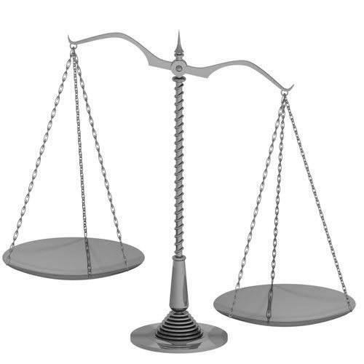
Terms
Department of Computer Engineering
Digital Comparator:
Data comparison is needed in digital systems while performing arithmetic or logical operations.
This comparison determines whether one number is greater than, equal, or less than the other number.
A digital comparator is widely used in combinational systems and is specially designed to compare the relative magnitudes of binary numbers.

Slide 5
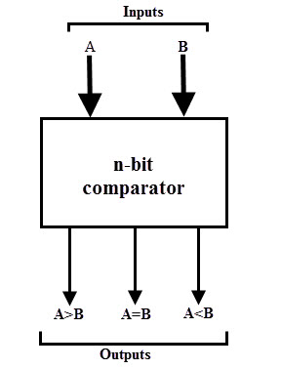
n-bit Comparator:

Slide 6
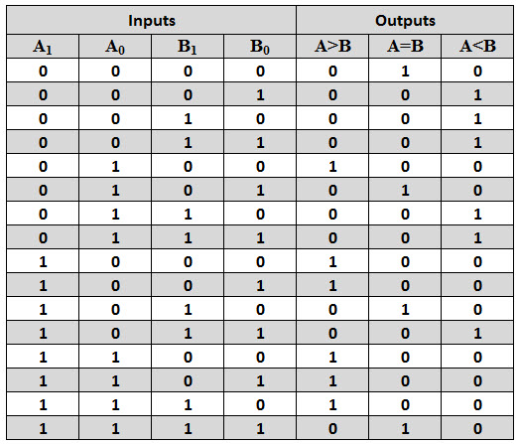
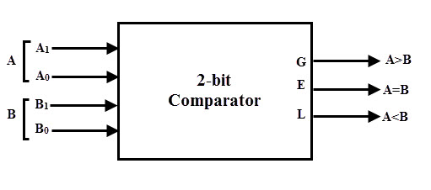
2-bit Comparator:

Slide 7
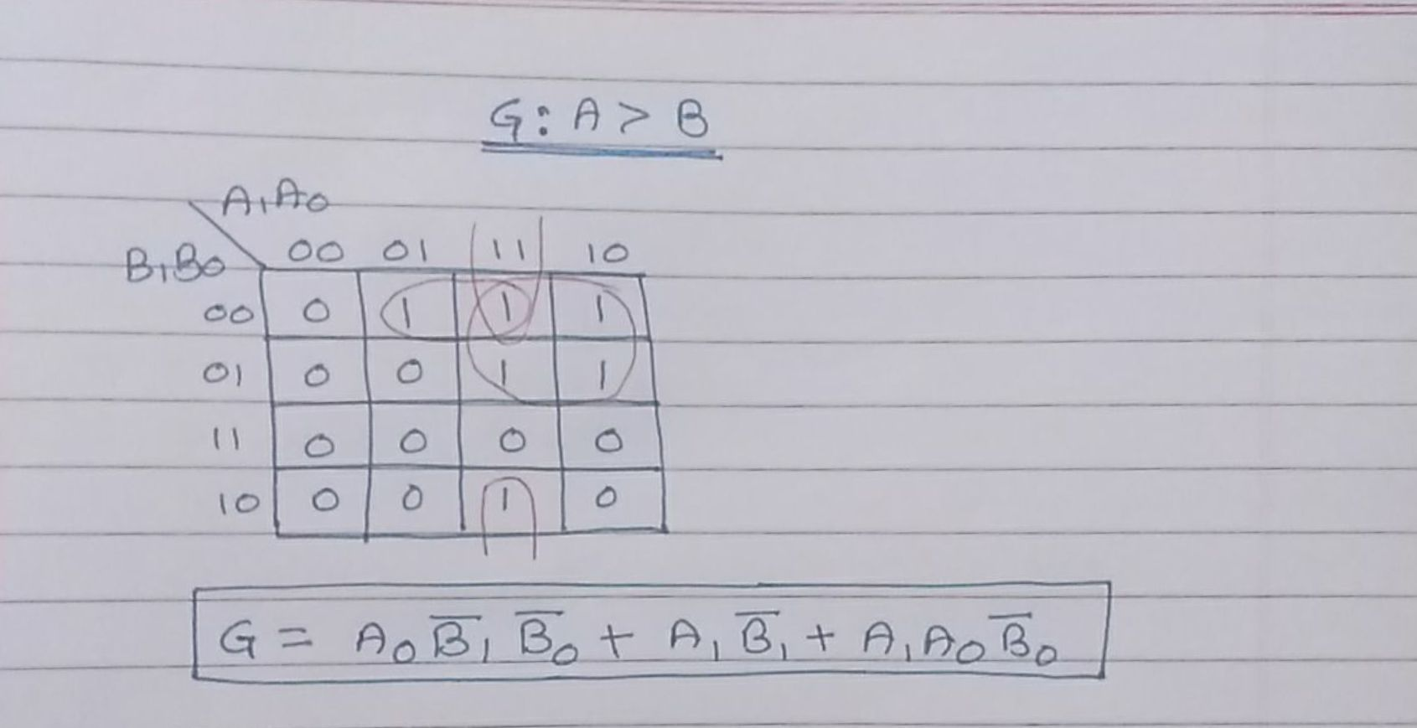
K-Map simplification:

Slide 8
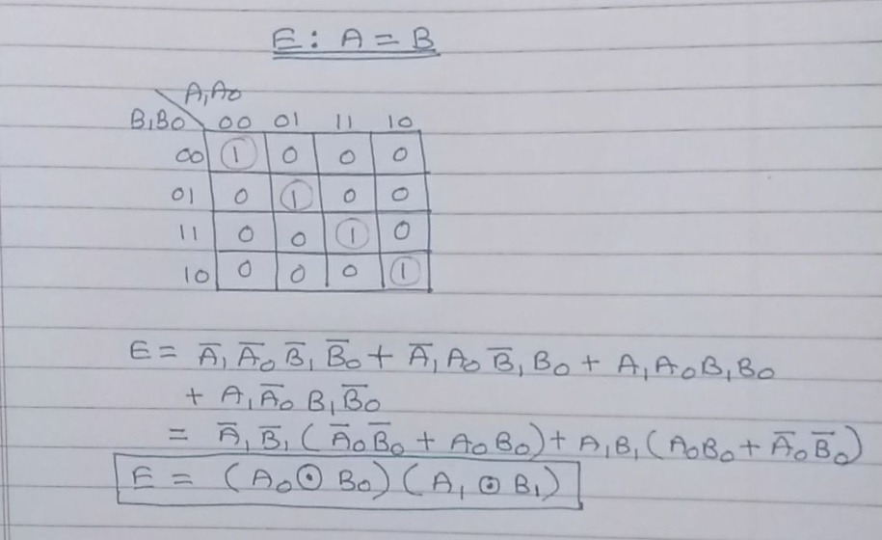
K-Map simplification:

Slide 9
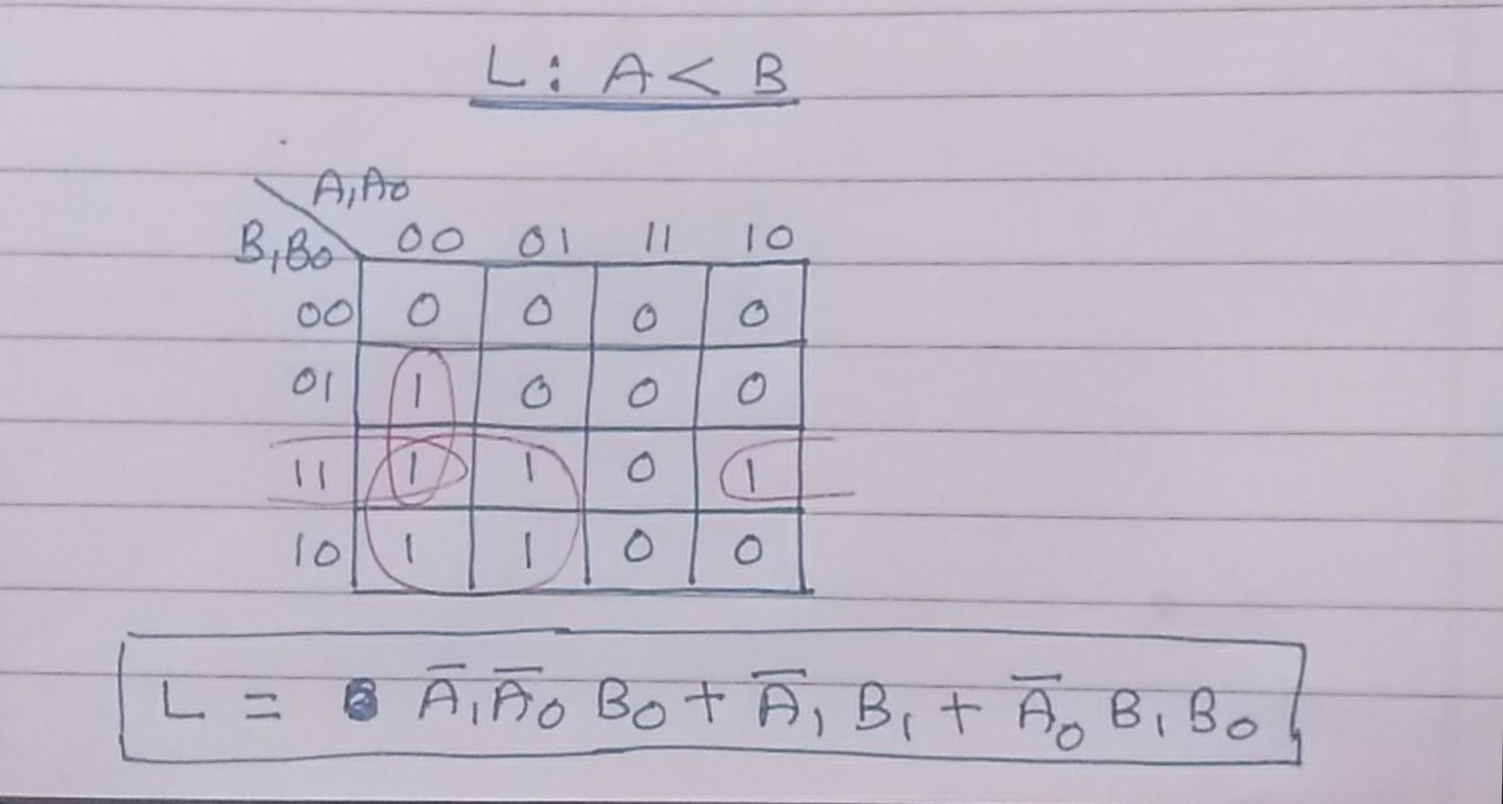
K-Map simplification:

Slide 10
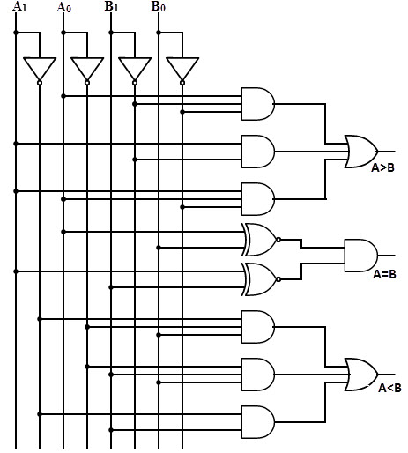
2-bit comparator: Circuit Diagram

Slide 11
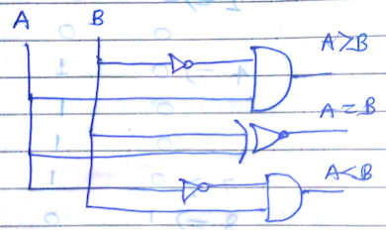
1 Bit comparator
Truth table
A > B
K map
B
0
1
A | B | A > B | A=B | A < B
0 | 0 | 0 | 1 | 0
0 | 1 | 0 | 0 | 1
1 | 0 | 1 | 0 | 0
1 | 1 | 0 | 1 | 0
A
0
0
0
F=AB’
1
1
0
A=B
B
0
1
A
Circuit diagram
0
0
1
F=A’ B’ +AB
1
0
1
A < B
B
0
1
A
0
0
1
F=A’ B
1
0
0

Slide 12
Points covered
Department of Computer Engineering
Digital Comparator
N-bit comparator
Design of 2-bit comparator
Design of 1-bit comparator
12

Slide 13
Department of Computer Engineering
Thank you

